Slide 1
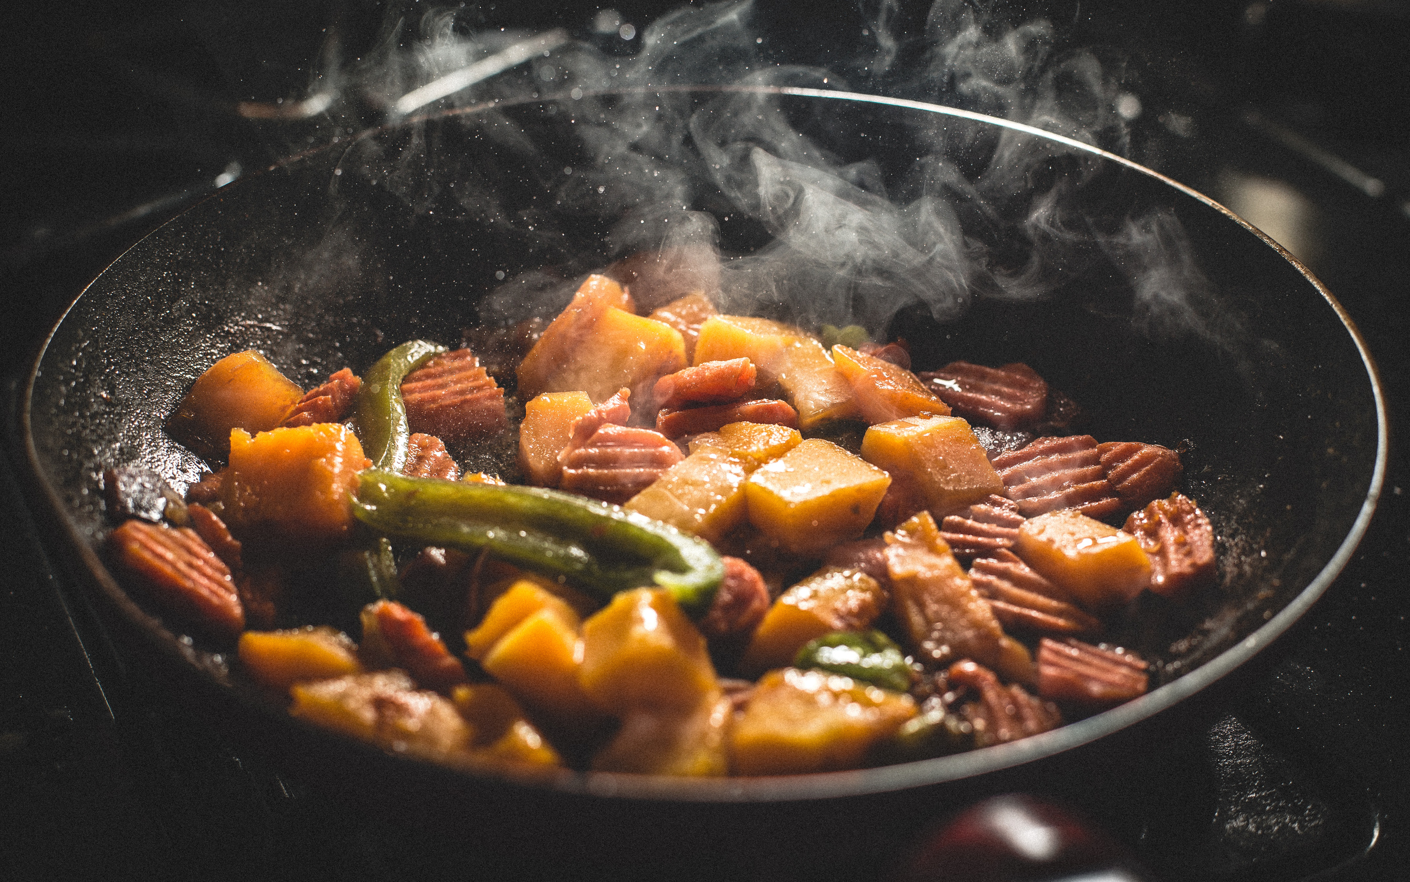

Social sip

Slide 2
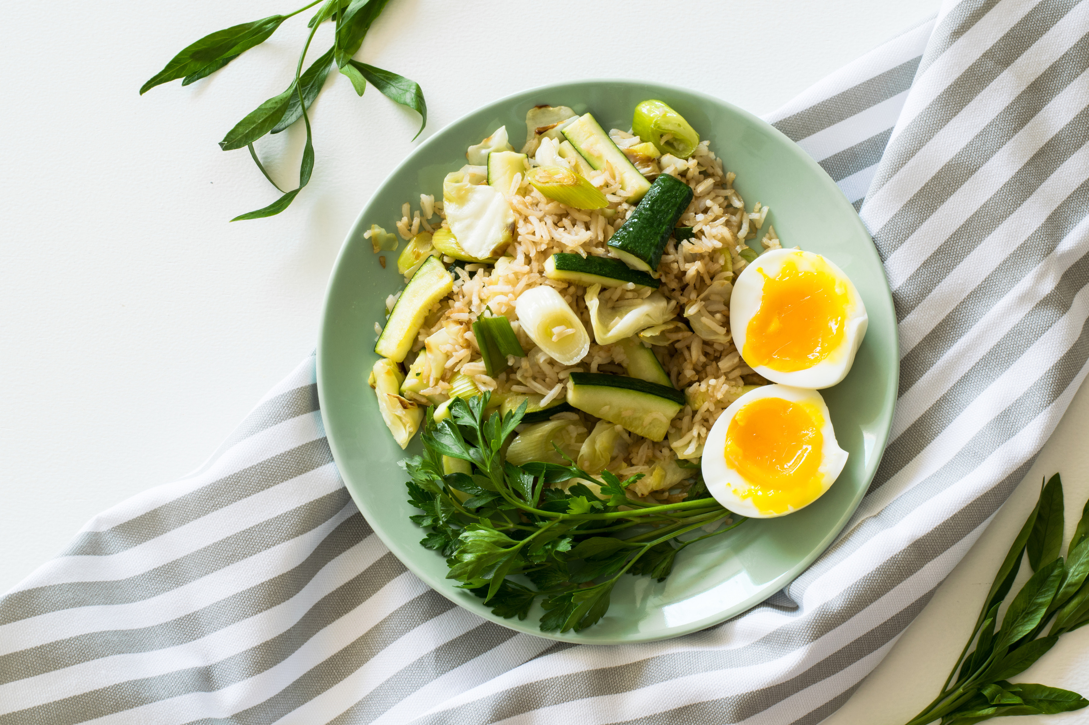
Idea
Welcome to Social Sip, your ultimate guide to culinary adventures! We're passionate food explorers dedicated to helping you discover the finest dining experiences near you. Our mission is to connect you with the best places to savor mouthwatering dishes and explore the diverse world of cuisine.

Slide 3


Technologies Used:-
HTML
CSS
JAVA SCRIPT

Slide 4

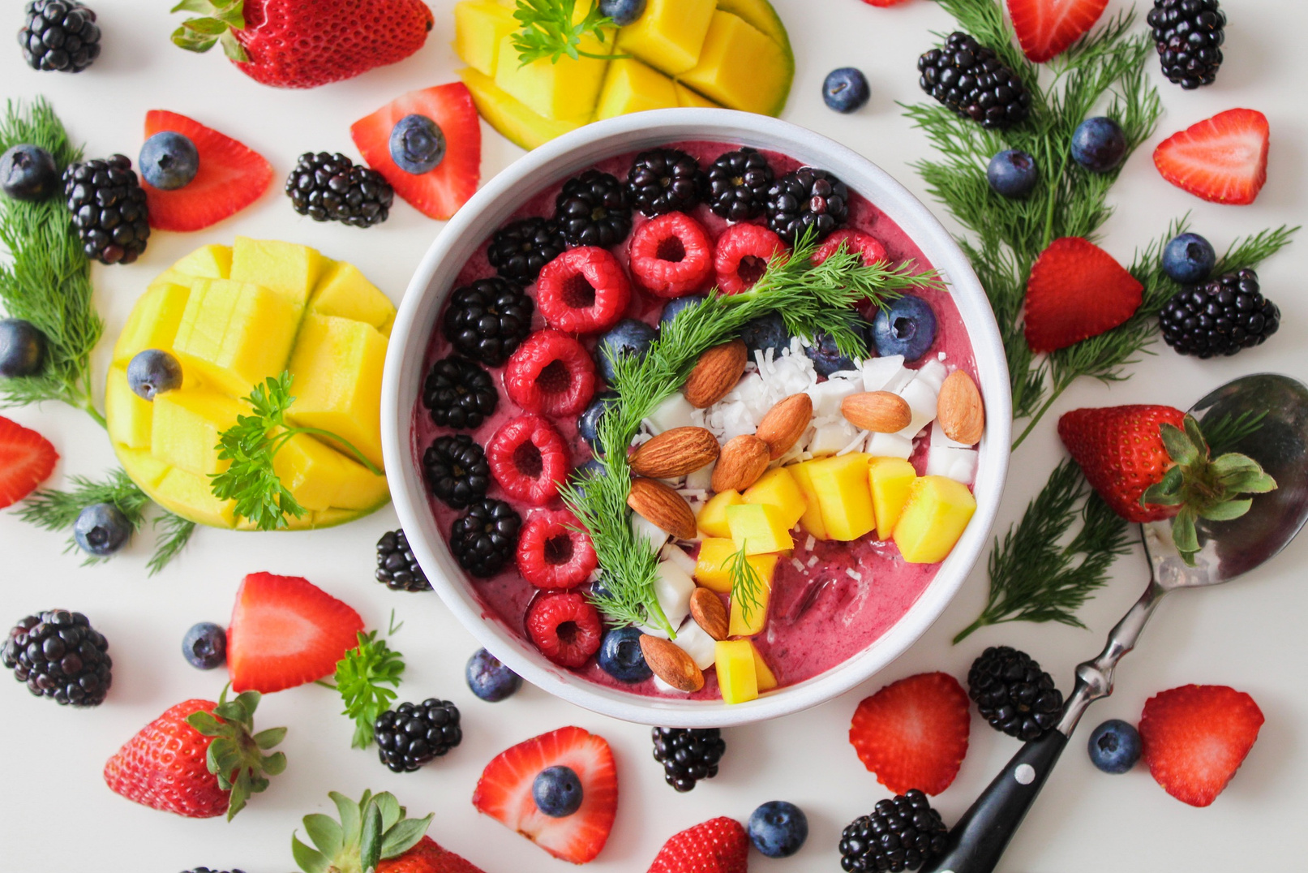
Functionalities
Search and Filter
User Reviews and Ratings
Upcoming Food Events, Festivals, Blogs.
Location-Based Services
Restaurant Reviews
Healthy Eating Guides
Function for Contacting
Newly Published

Slide 5
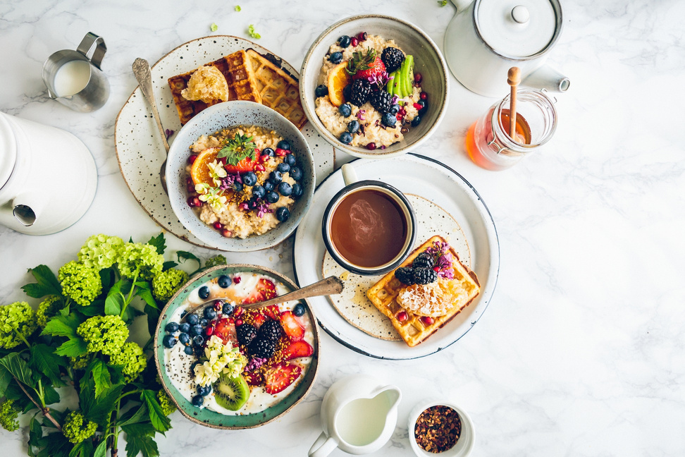
Future Scope
Location Detection
Real-Time Scanning
Personalized Suggestions
User-Friendly Interface
Detailed Information
Connect with the Community

Slide 6
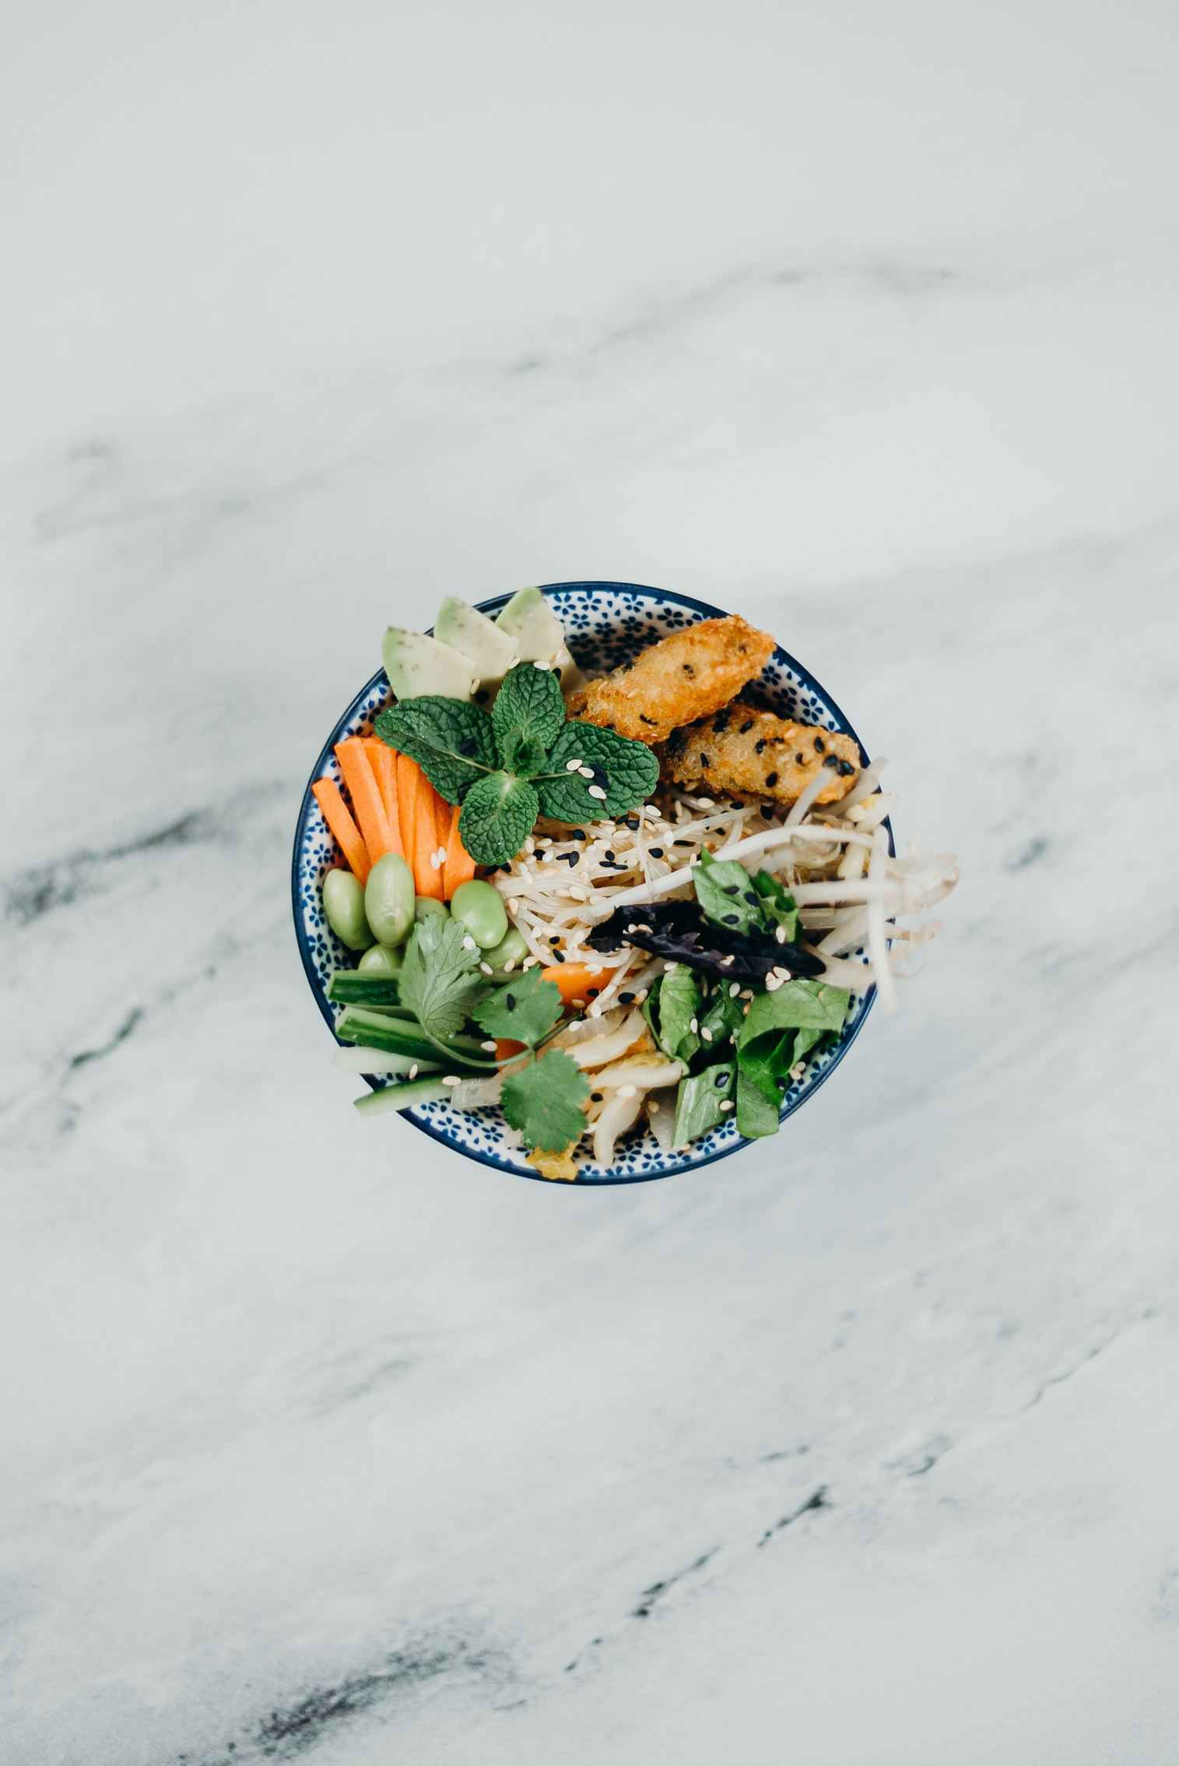
Thanks You
-Ayush Solanki
(2111981058)

